Slide 1




Text-based fake news classifier
Spot the Fake in a Flash — Trust Restored at the Speed of AI.
Submitted By:
Lotugada Jagan CL2025010601889779
R. Sai Sathvik CL2025010601922354
Sarada Prasanna Rath CL2025010601889577
Subham Subhrajyoti CL2025010601934246

Slide 2

Motivation
Fake news undermines trust in media and has the potential to disrupt democratic processes, such as influencing elections or spreading harmful misinformation, especially during crises like the COVID-19 pandemic.

Slide 3
Let's look at the Contents
What’s a Fake?
How Fakes Spread Online
Why It Matters
Project Goal
How Our Tool Works
Data We Used
Results
Limits & Caution
Model Architecture
Key Takeaway

Slide 4

What’s a Fake ?
A fake is any picture, video, voice, or article that a computer makes to look real even though it’s not. Fakes can be used to swap faces in videos, create audio where a person is saying something they didn't, or even generate completely fabricated images or videos and Text.

Slide 5

How Fakes Spread Online
False news can spread through circular reporting, where one source publishes misinformation that is picked up by another news outlet, who cites the original source as evidence that the information is accurate. This continues as other news outlets report the misinformation and perpetuate the cycle. Someone makes the fake, automated accounts share it everywhere, many people see it, believe it, and harm can follow.

Slide 6

Why It Matters ?
False stories now travel online faster than the truth and can hurt elections, companies, and people. We need a quick way to catch them

Slide 7

Project Goal
The goal of our project is to build a text-based fake news classifier using machine learning techniques to detect and prevent the spread of misinformation by analyzing and verifying news content.

Slide 8

How Our Tool Works
Our project leverages Python-based tools and libraries such as TensorFlow/Keras for model building, Pandas for data handling, Scikit-learn for preprocessing, and GloVe for word embeddings, with platforms like Kaggle for dataset exploration and collaboration.

Slide 9

Data We Used
Dataset:
Kaggle “Fake and Real News Dataset.”
Files included:
Fake.csv ≈ 23.5 k fake‑news articles
True.csv ≈ 21.4 k authentic articles
Features:
Title, text, subject, date
Class balance:
Near‑equal fake vs. real samples reduces model bias.
Utility:
Rich, labelled text pairs perfectly with GloVe embeddings and deep‑learning (CNN + BiLSTM) architectures to learn both local patterns and long‑range context for fake‑news detection.

Slide 10
Results
The hybrid CNN-BiLSTM model achieved strong performance in detecting fake news with the following evaluation metrics:
Test Accuracy: 96.2%
Precision: 97%
Recall: 95.5%
F1-Score: 96.2%
These results indicate that the model is highly effective in distinguishing between real and fake news articles.

Slide 11
Limits & Caution
Label Reliability
Fake vs. “Real” labels are binary; they don’t capture satire, partially true stories, or opinion pieces edge cases can confuse the model. Source‑based labeling means an entire outlet’s articles are tagged the same, risking overfitting to publication style rather than veracity.
Text‑Only Features
No social‑context signals (shares, user credibility) or metadata like author reputation; purely lexical signals can miss subtler cues. Headline/body mismatch isn’t explicitly modeled, so click‑bait headlines may slip through.

Slide 12
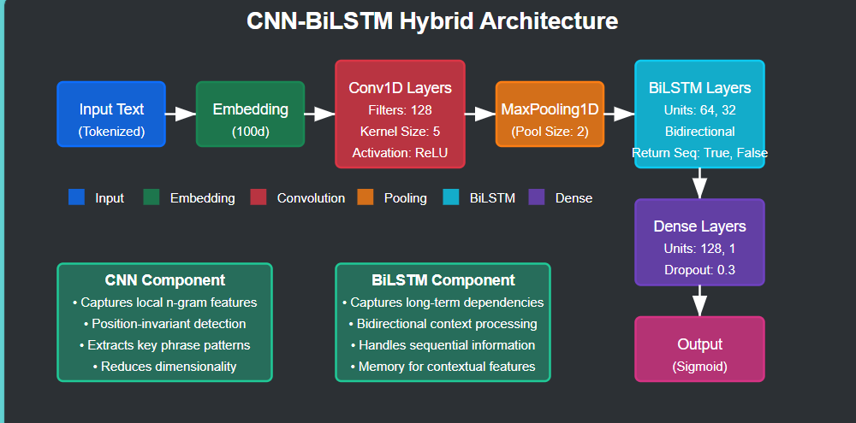
Model Architecture

Slide 13
Key Takeaway
The combination of CNN for local pattern extraction and BiLSTM for context understanding proves highly effective in detecting subtle cues and long-range dependencies in news text. The model shows strong potential for real-world applications, such as fake news flagging on social media or news platforms, with future improvements focused on integrating more advanced language models and incorporating metadata for even greater accuracy.

Slide 14
Conclusion
In this project, we have successfully developed a hybrid CNN-BiLSTM model for fake news detection, leveraging pre-trained GloVe embeddings to enhance the model's understanding of semantic relationships in text. By combining the power of CNNs for local feature extraction and BiLSTMs for capturing long-range dependencies, the model achieves high accuracy and generalizes well to unseen data.

Slide 15
THANK YOU

